Slide 1
AI : Tools of the Trade

Slide 2
IN THIS PRESENTATION
Python
Jupyter Notebooks
Nvidia / CUDA
VSCode
Excel
Pipelines

Slide 3

Python
AI programming is done in Python
Lots of libraries, including for scientific / numeric work: numpy, scipy, scikit-learn, etc.
Library for manipulating data sets: Pandas
Libraries for deep learning work:
Keras
Tensorflow*
PyTorch
Python itself is very slow, but easy to use. Functionality that needs to be fast is written in C and then called from within Python.
* A “tensor” is a collection of numbers, such as columns of measurements

Slide 4
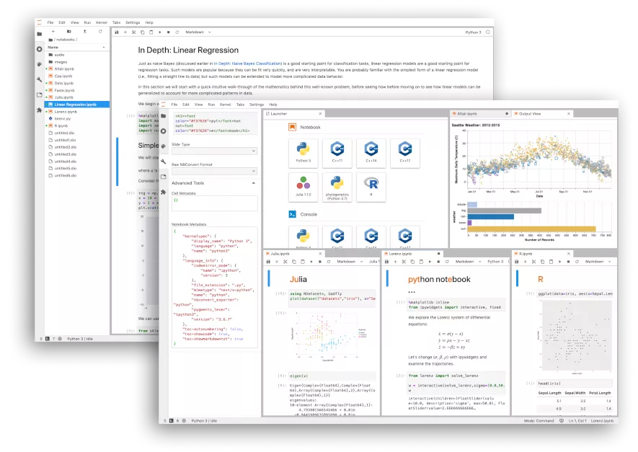
Jupyter Notebooks
A “Notebook” is a file that contains program code, text and images.
Jupyter Notebooks were originally developed for use with Python, though they can now use other programming languages.
Notebooks are used for data science and other types of development where the explanation of the code is as important as the code itself.
Jupyter Notebooks help make data science and AI experiments easier to reproduce.
AI and data companies have started to run entire processing pipelines inside Jupyter Notebooks.

Slide 5
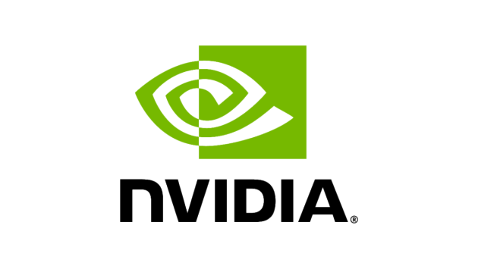
Nvidia (1): GPUs
Deep learning and AI involves a lot of calculations.
Calculations inside a neural network layer do not need to happen sequentially. Performing them simultaneously is much faster.
The calculations themselves are very simple (addition, multiplication).
A CPU (“Central Processing Unit”) is good at complex calculations but can only perform one calculation at a time.
A GPU (“Graphics Processing Unit”) is a device for performing lots of simple calculations simultaneously. They are used for gaming.
Nvidia is the largest manufacturer of gaming cards (GPUs) in the world.

Slide 6
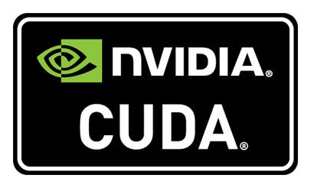
Nvidia (2): CUDA
Unlike other GPU manufacturers, which cater only to gamers, Nvidia has create a tool specifically for performing many calculations simultaneously on their hardware.
Unlike other GPU manufacturers, which cater only to gamers, Nvidia has create a tool specifically for performing many calculations simultaneously on their hardware.
This tool, CUDA, makes doing such calculations much, much faster than doing them on the CPU.
Machine learning and AI benefit enormously from using this tool.
Because no other manufacturer of GPUs has such a tool, CUDA has become a de facto standard in ML and AI.
Because CUDA can only be used with Nvidia GPUs, Nvidia has now become one of the largest companies in the world.

Slide 7
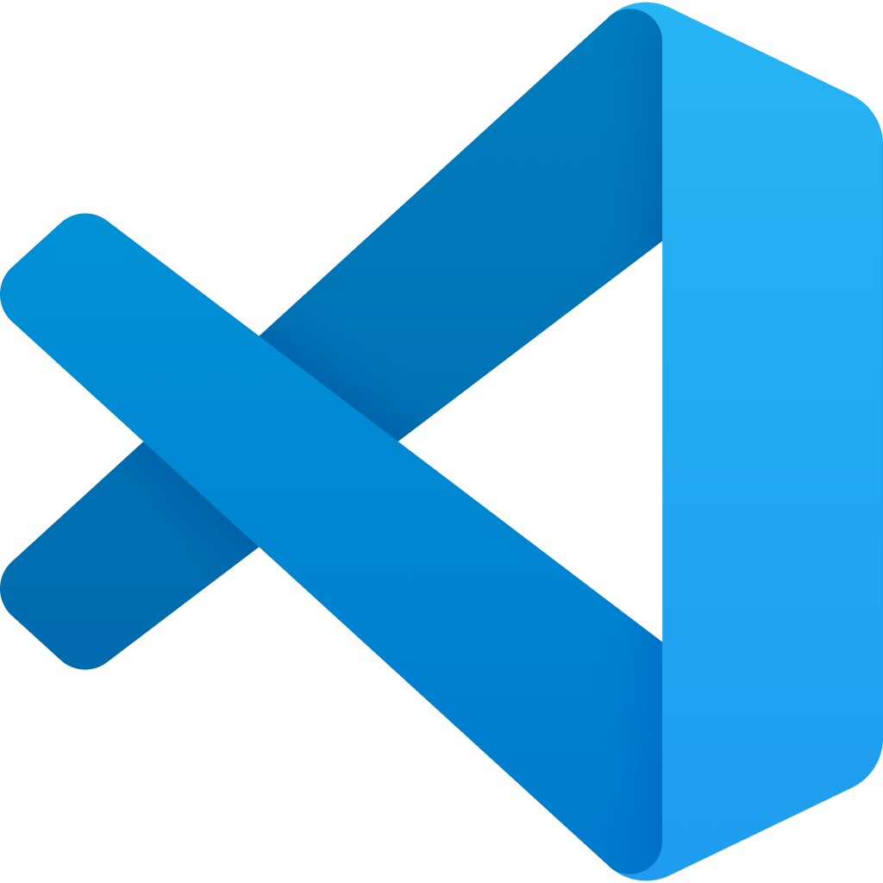
VSCode
VSCode is an editor for program code.
Made by Microsoft.
Free.
De facto standard editor except for certain specialized tasks.
Lots of plugins for different programming languages and tools.
Can run Jupyter Notebooks right inside the editor!
Can also be run online as the editor for GitHub.

Slide 8
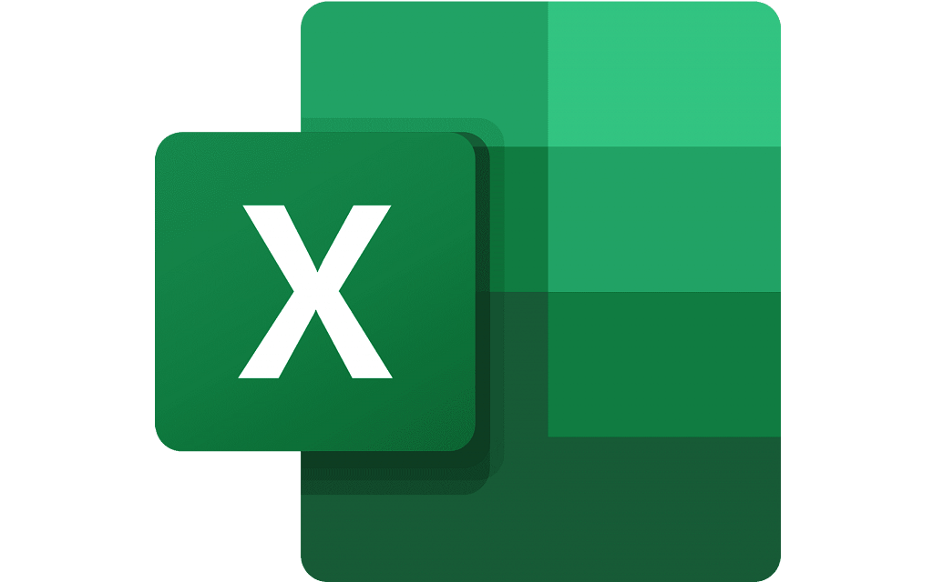
Excel
Not a good tool for AI.
“Programming” in Excel is awful.
BUT lots of data is stored in Excel files.
So lots of AI and ML processes make use of them.

Slide 9
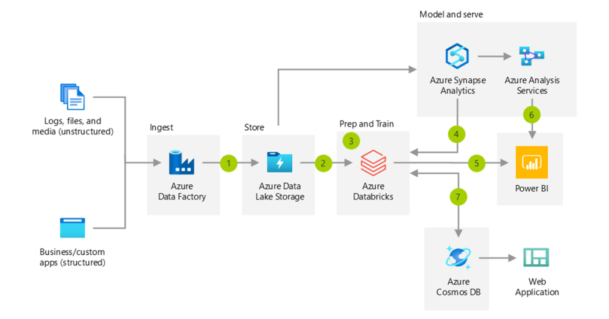
Pipelines
Data science, AI and ML projects often consist of so-called “pipelines”.
In a pipeline data is read in from many different sources. It is then processed and prepared before an AI application can be trained on it. The output of the AI application is then sent to different applications for further processing.
Pipelines can be run locally, but are often run “in the cloud”.
All cloud providers, uhm, “provide” them.
Cloud providers, uhm, “provide” all sorts of tools for working with pipelines.
Eg. Azure has data bricks, data factory, Power BI, etc, etc.

